Slide 1



Adding Seeds, UCID’s & Mailing References for Advertising Mail and Partially Addressed Services V1
Advertising Mail and Catalogue Mail Adding Seeds (Mandatory)
Initially the 2 seed addresses below must be added into the raw data before the data is run through the mail sort software so it is inserted into the correct container appropriately.
Royal Mail Sample UCID XXXXXX- XXXX
Mailing Reference OUT
Royal Mail Wholesale
PO Box 72662
London
E1W 9LD
Client Services UCID XXXXXX- XXX
The Delivery Group
Unit 2 Catalina Approach
Omega South
Warrington
WA5 3UY
Partially Addressed Adding Seeds (Mandatory)
Initially the 2 seed addresses below must be added into the raw data before the data is run through the mail sort software so it is inserted into the correct container appropriately.
Partially Addressed UCID XXXXXX- XXX
The Delivery Group
Unit 2 Catalina Approach
Omega South
Warrington
WA5 3UY
Alternatively for Partially Addressed you may send a seed/sample to us in electronic format by submitting a PDF by email to PDFseeds@thedeliverygroup.co.uk (or such other address as we may notify you of from time to time). If you are sending us a seed/sample in PDF format by email, you must send us the following information:
email title: Partially Addressed Mail Sample for [customer name];
pdf attachment(s) to include front and back of outer and all inner content;
Date of posting;
UCID number;
SCID number; and
eManifest ID.
Job Reference from Docket Hub
 | The Delivery Group reserve the right to remove the advertising discount at any time before or after the mailing has been sent if it is found to be non-compliant or any of the above procedures have not been adhered to.
www.thedeliverygroup.co.uk People | Partnership | Performance
www.thedeliverygroup.co.uk People | Partnership | Performance

Slide 2
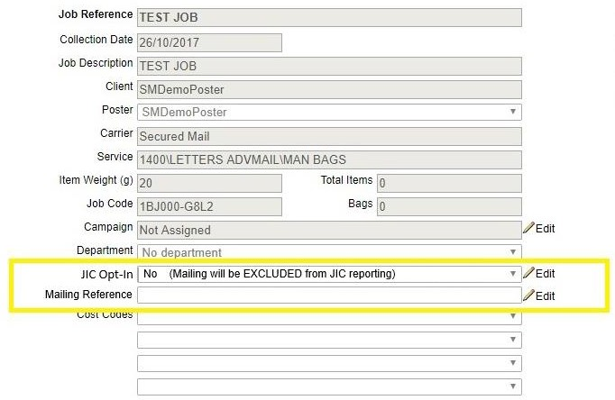
Adding Seeds, UCID’s & Mailing References for Advertising Mail and Partially Addressed Services V1
Adding UCIDs (Mandatory for both Partially Addressed and Advertising Mail)
Once the data has been mail sorted the two addresses above need to be found and the UCID needs to be added into the output file that the mail sort has produced so that the mail piece then has this UCID printed on it upon production. This can be achieved using a ‘find’ function in notepad and searching for ‘UCID’ then changing the UCID from ‘XXXXXX-XXXX’ to the correct UCID number.
The UCID and Mailing Reference can be found in the Mailing Summary Screen as outlined below. Your applicable UCIDs can also be obtained from your Delivery Group Account Manager or by contacting ucid@thedeliverygroup.co.uk
UCID
 | The Delivery Group reserve the right to remove the advertising discount at any time before or after the mailing has been sent if it is found to be non-compliant or any of the above procedures have not been adhered to.
www.thedeliverygroup.co.uk People | Partnership | Performance
www.thedeliverygroup.co.uk People | Partnership | Performance

